Slide 1
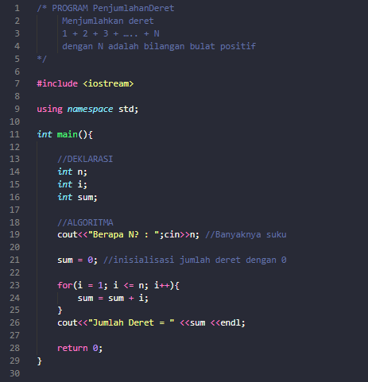
PENGULANGAN FOR
05/03/2022
1

Slide 2
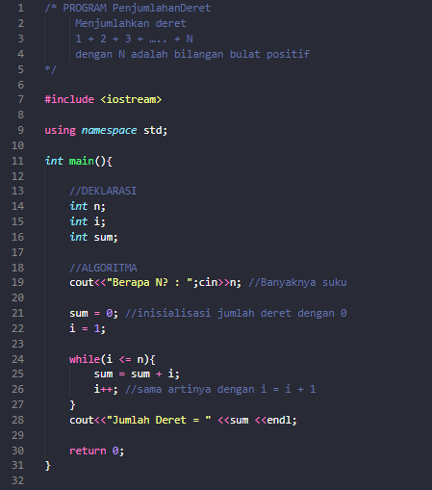
PENGULANGAN WHILE
05/03/2022
2

Slide 3
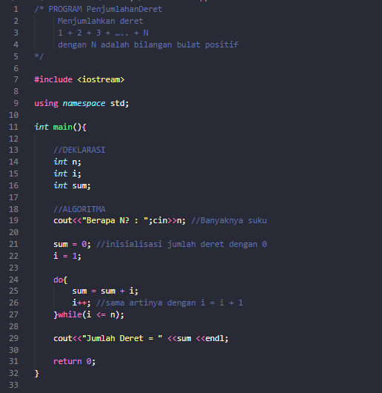
PENGULANGAN DO WHILE
05/03/2022
3

Slide 4
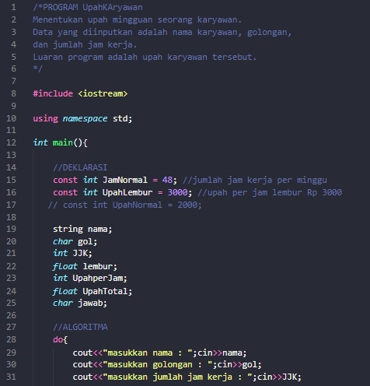
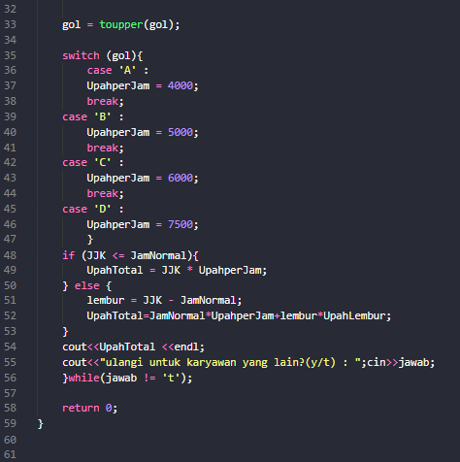
PROGRAM UPAHKARYAWAN
05/03/2022
4

